Slide 1

Power Supply Calibration Automation Project
Nimesh Kavinda Fernandopulle

Slide 2
Content
Introduction to the Project.
Problem Statement & Objectives of the Project.
Methodology for Implementation of Project.
Project Schedule Plan.
What I have done so far.
Challenges faced.
Current progress.
Next step …..

Slide 3
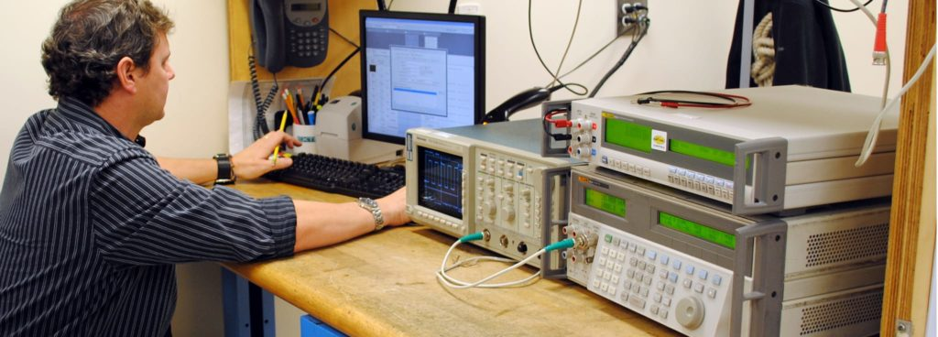
Exist Software for Calibration
VARIOSYSTEMS' power supply calibration process involves a Windows app where operators manually connect probes for voltage and current measurements, making it time-consuming. To boost efficiency, they seek to automate probe connections, reducing manual oversight.
Operators must stay on-site to change probes, leading to time wastage.

Slide 4

Objectives of the Project.
This Project aims to automate power supply calibration, minimizing manual tasks and optimizing operator resources. The project involves developing a new Windows application, generating comprehensive reports, and enhancing documentation capabilities for quality assurance. Ultimately, it seeks to create a more efficient and streamlined calibration process.

Slide 5

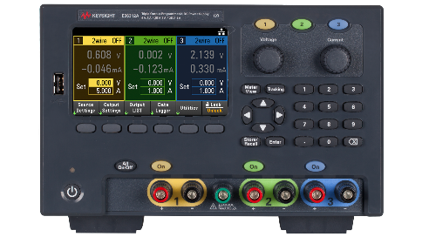
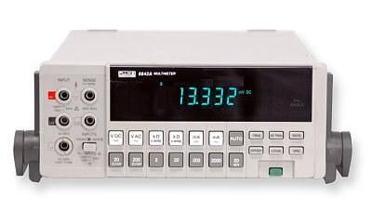
Methodology
Windows Program
Readings
Signals
Controlling Signals
Power Supply
Multimeter
Controlling
Signals
Switching Unit
Output Probes
Measuring Probes

Slide 6
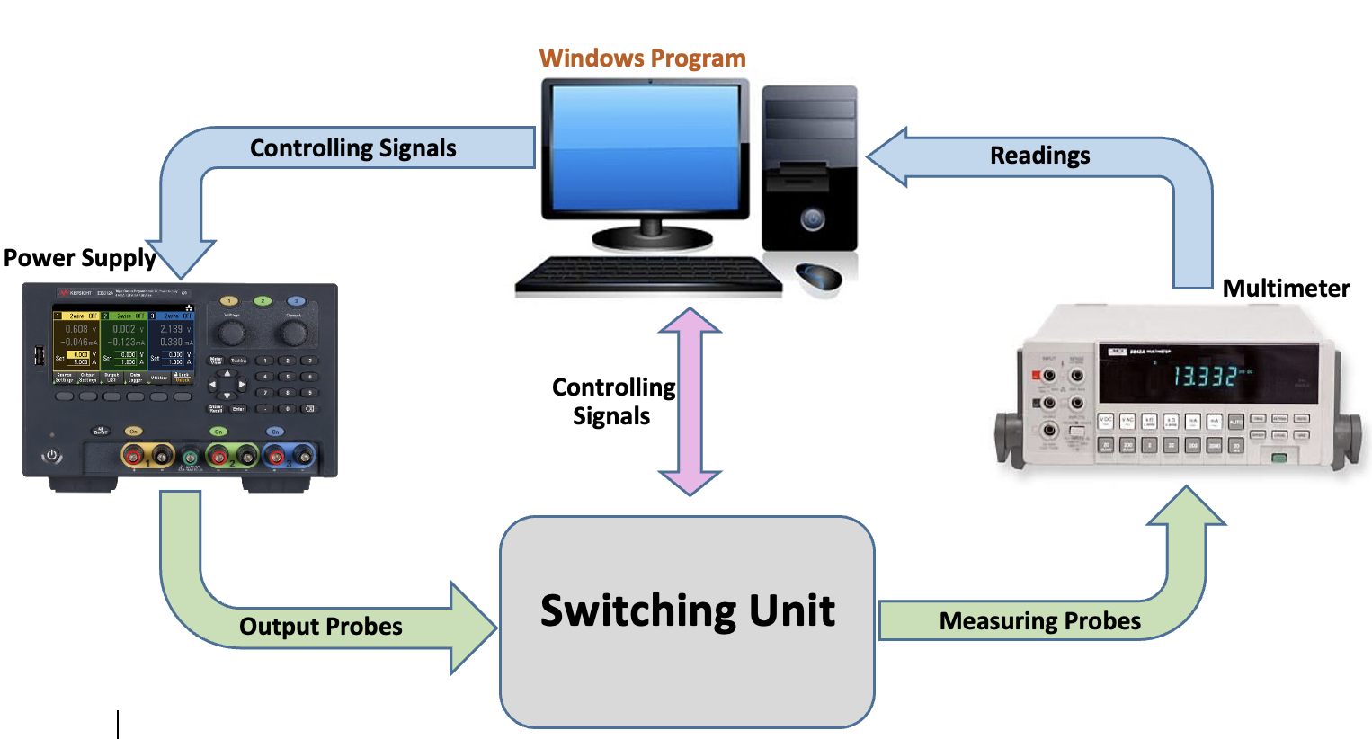
Main Features
Intermediate Switching Unit
Windows Application
Report Generation

Slide 7
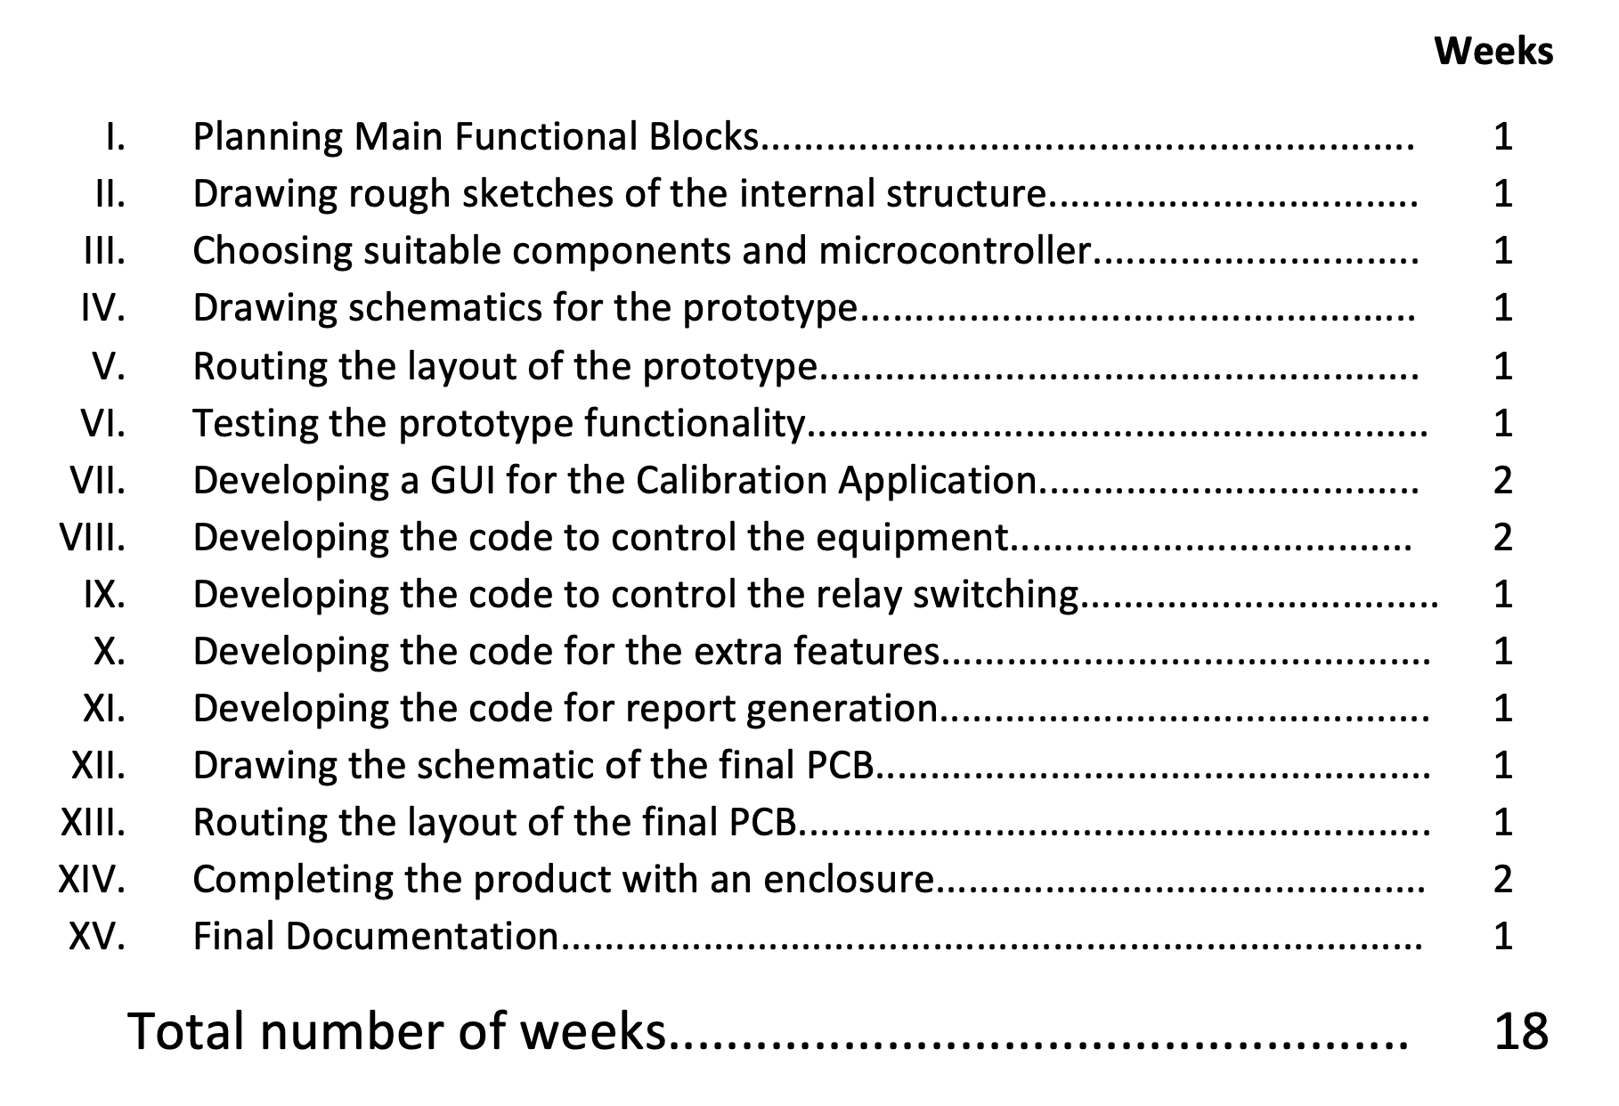
Project Schedule Plan

Slide 8
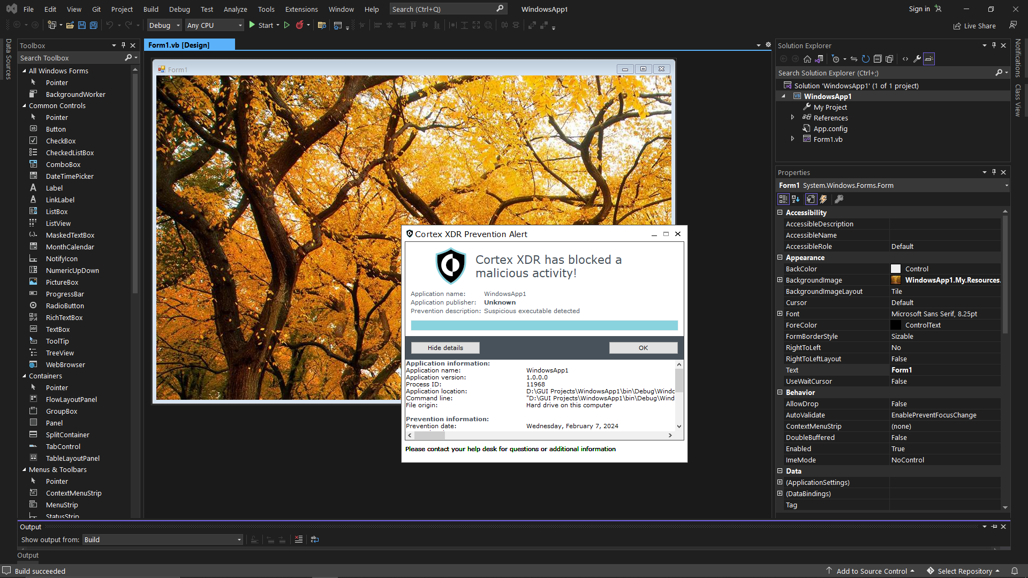
Challenges Faced.
Windows Application Development.
Can not run .exe files.

Slide 9




What I have done so far.
Planning the block diagram of the switching unit.
Choose a microcontroller.
Drawing the schematic of prototype.
Routing the layouts of prototype.
Developed Controlling user interface.
Choosing a programming language to develop GUI.
That GUI contains , Sign in & Sign Out options , Device connection page , calibration progress page and excel report generation containing graphs.

Slide 10
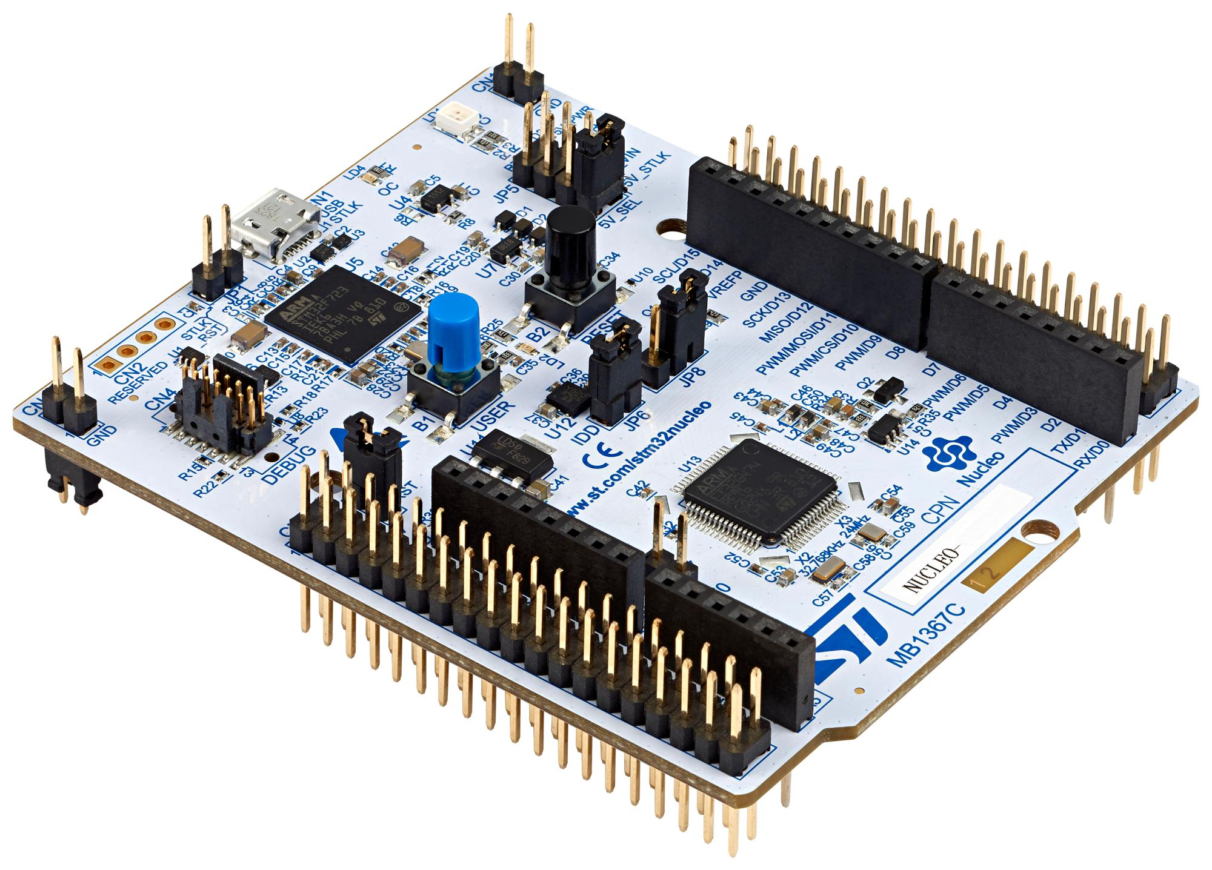
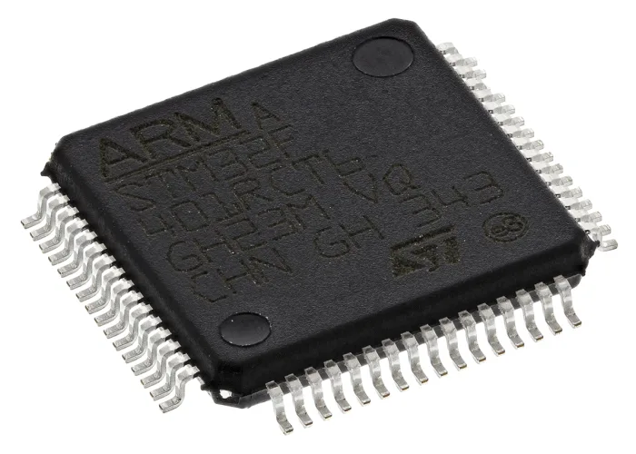
Choose a microcontroller. STM32 F401RC

Slide 11
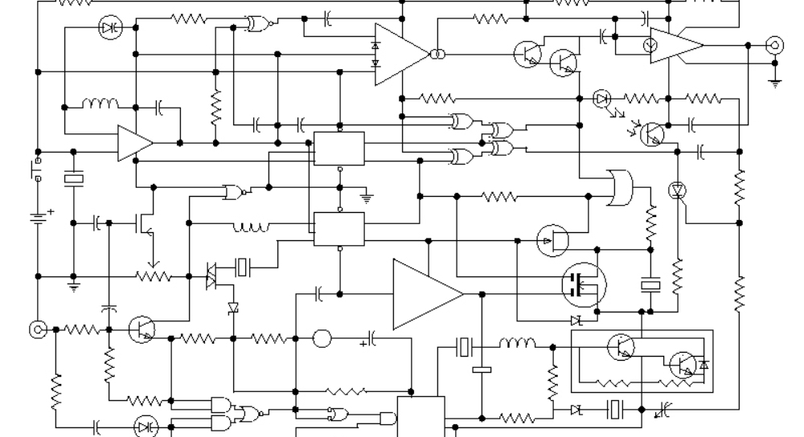
Drawing the schematic of prototype
Relay Matrix.
Controlling Unit.
Power supply.

Slide 12
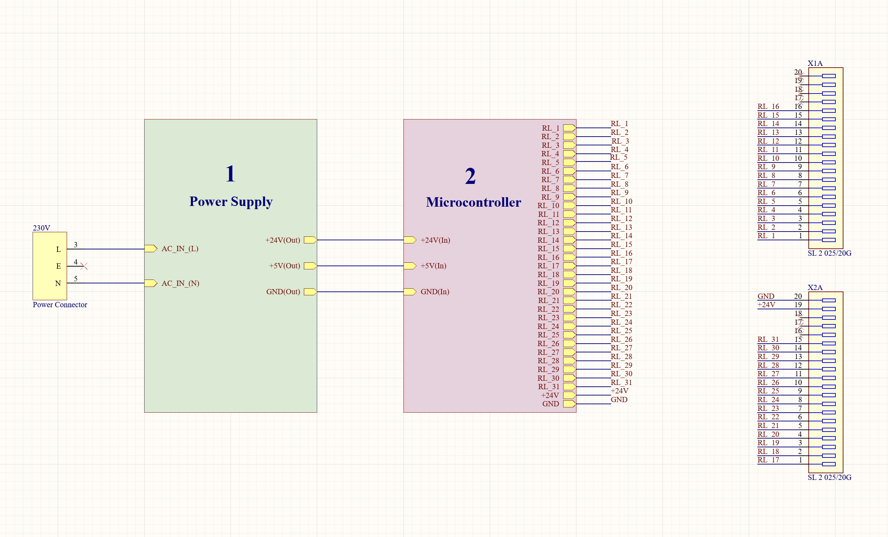
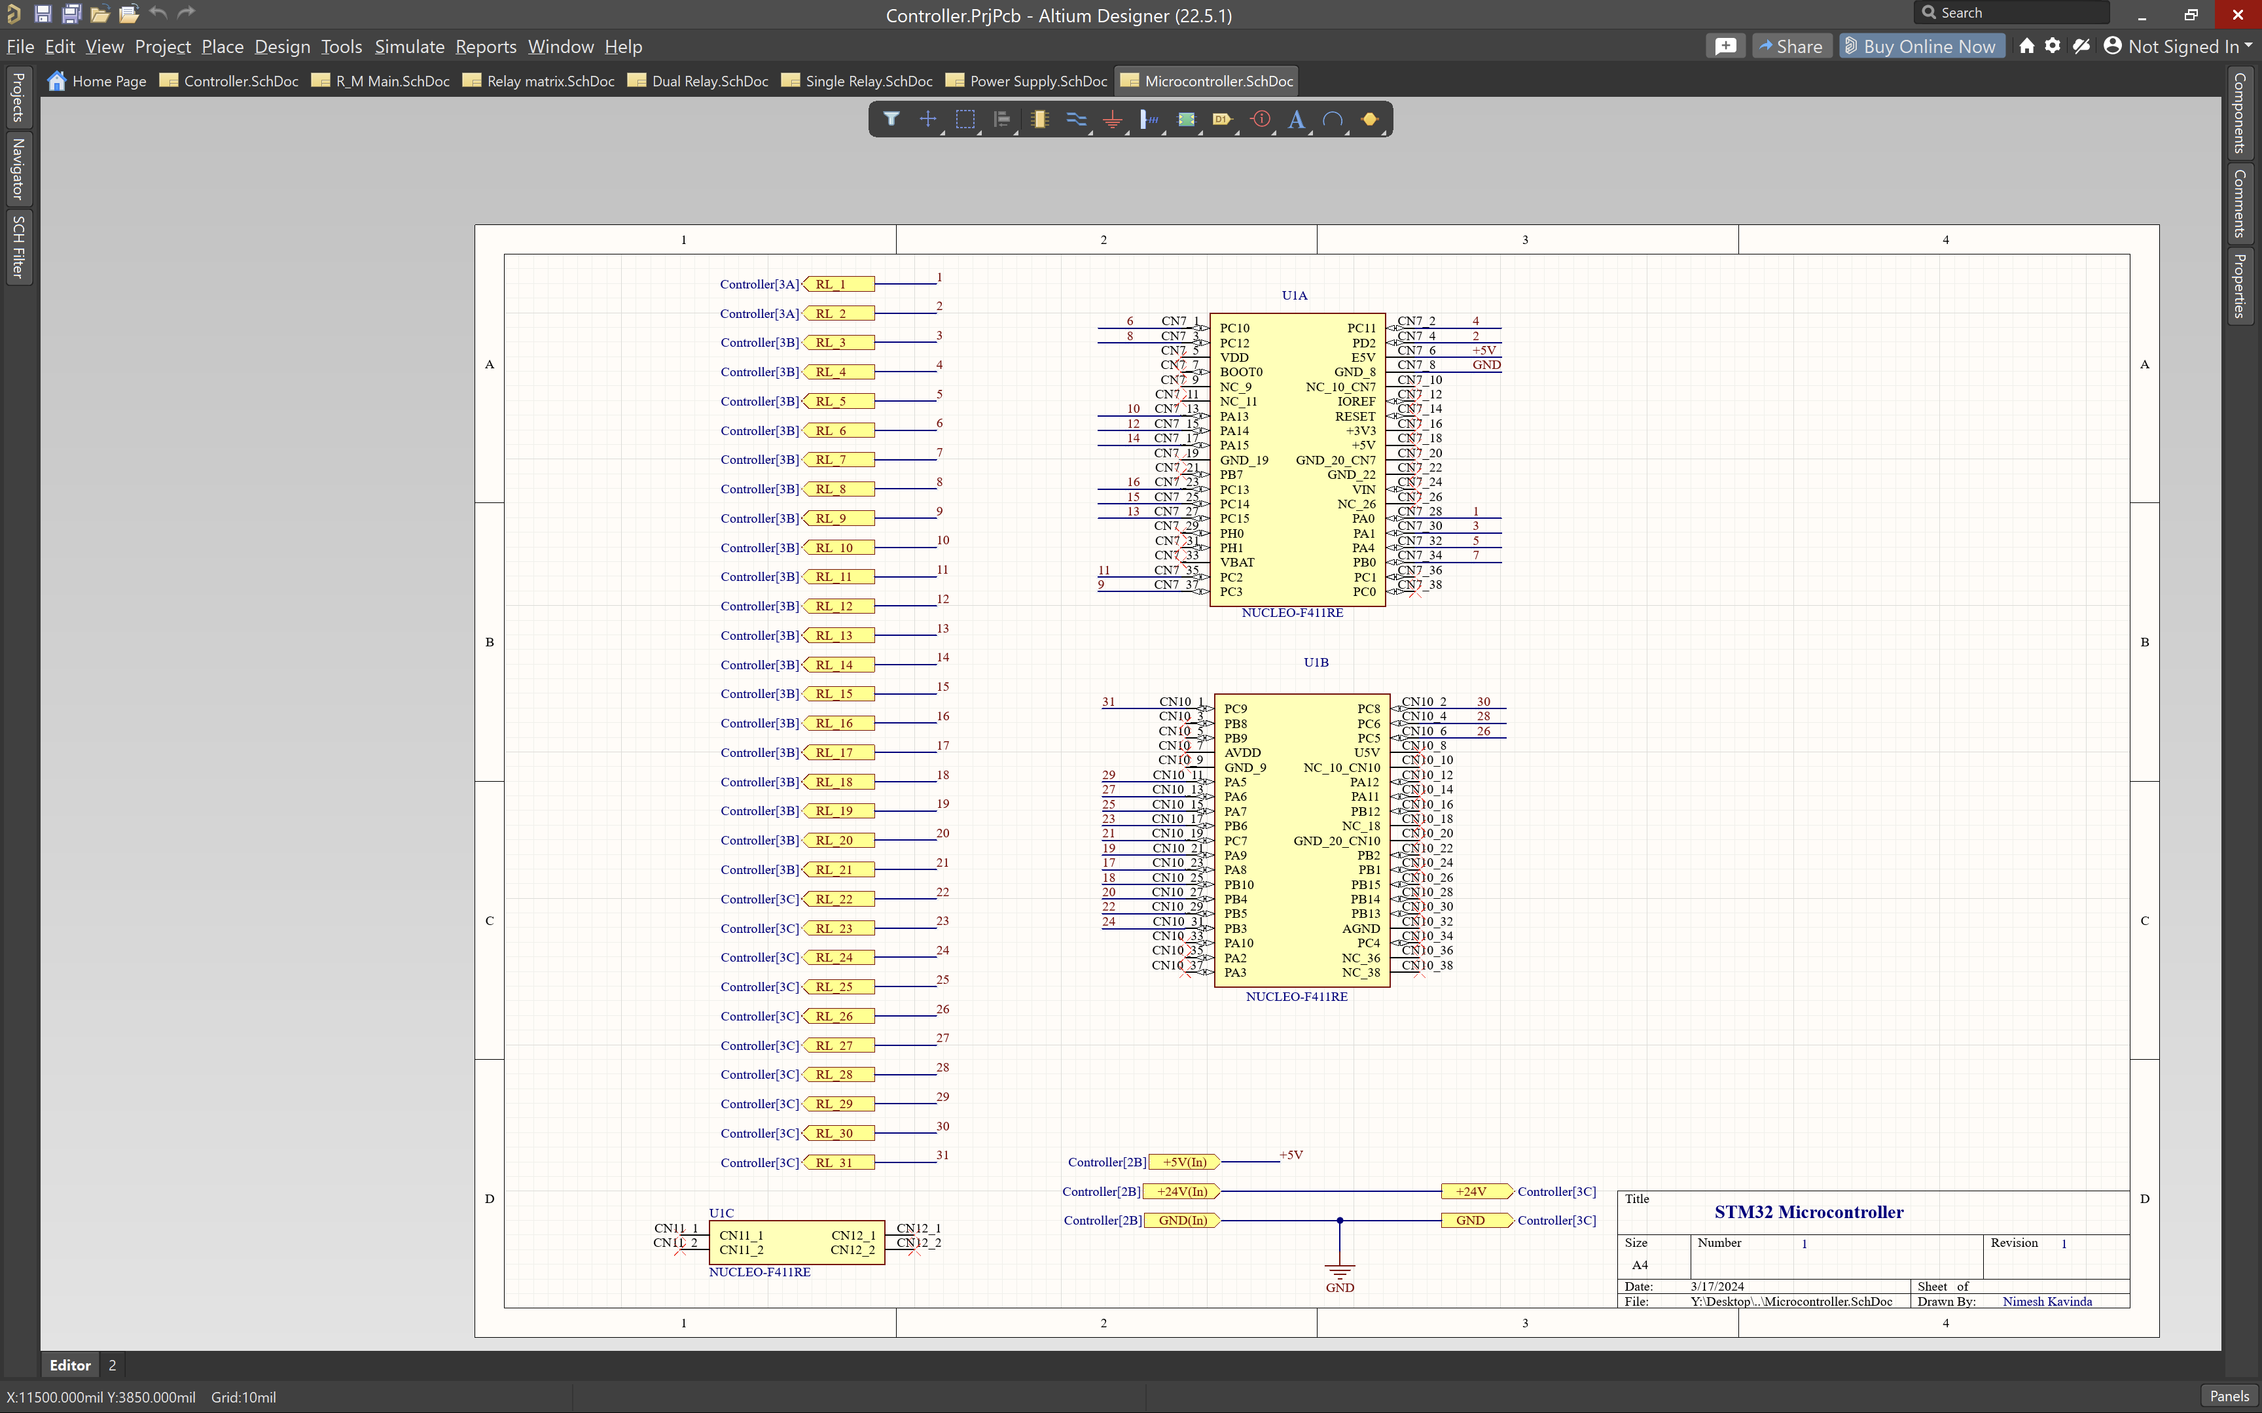
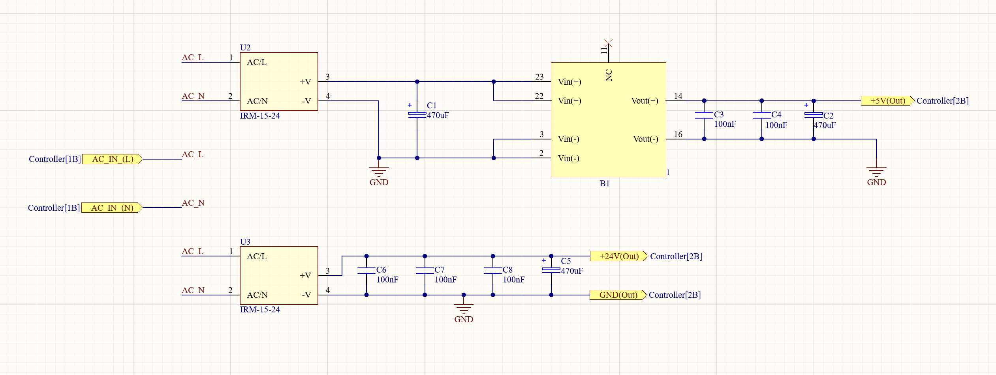
Power supply & Controller

Slide 13
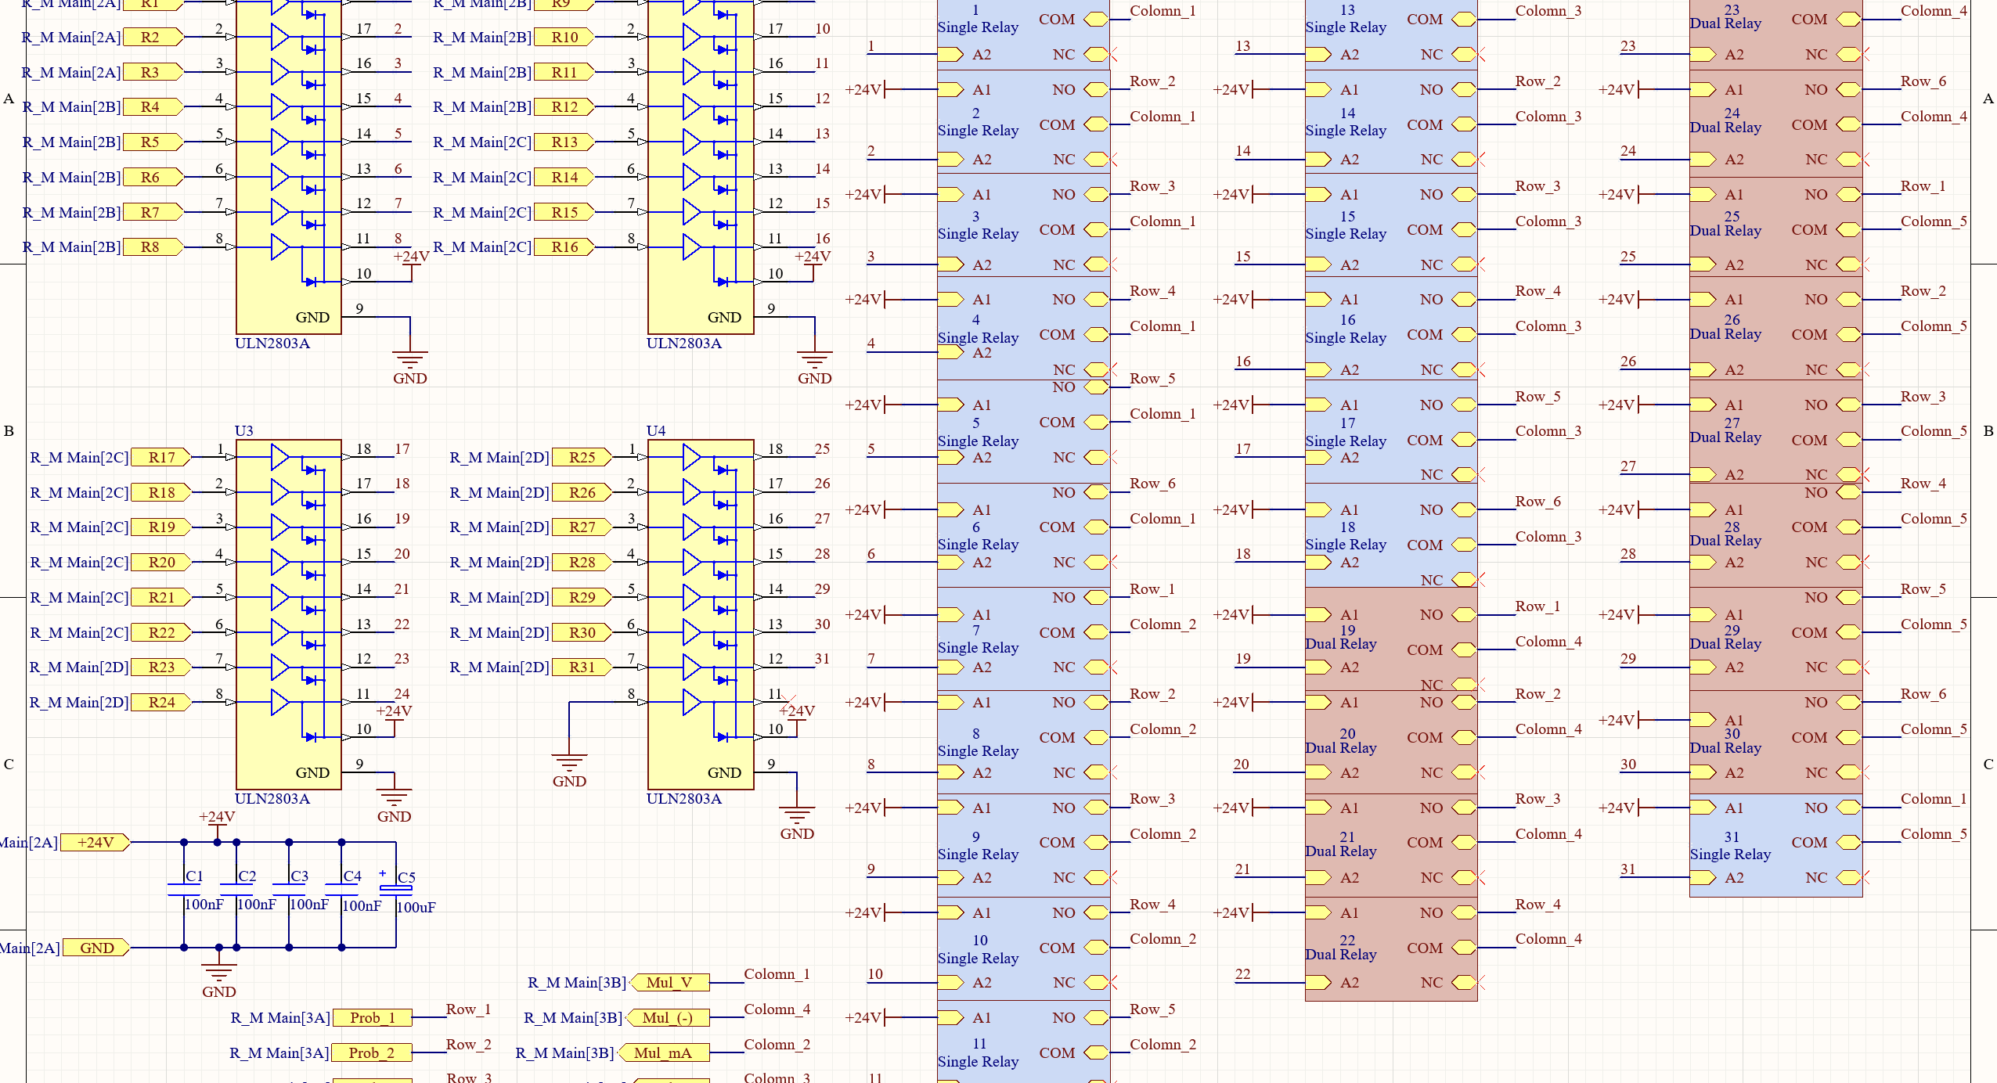
Relay Matrix

Slide 14
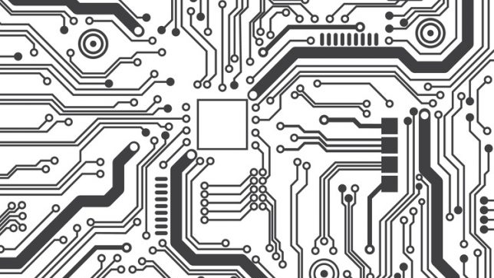
PCB Layouts
Relay Matrix.
Controlling Unit.
Power supply.

Slide 15

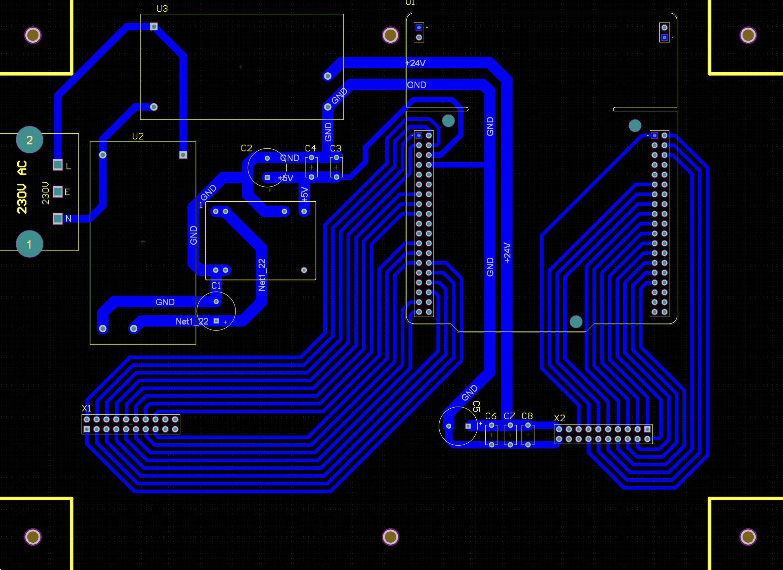
Power supply & Controller

Slide 16
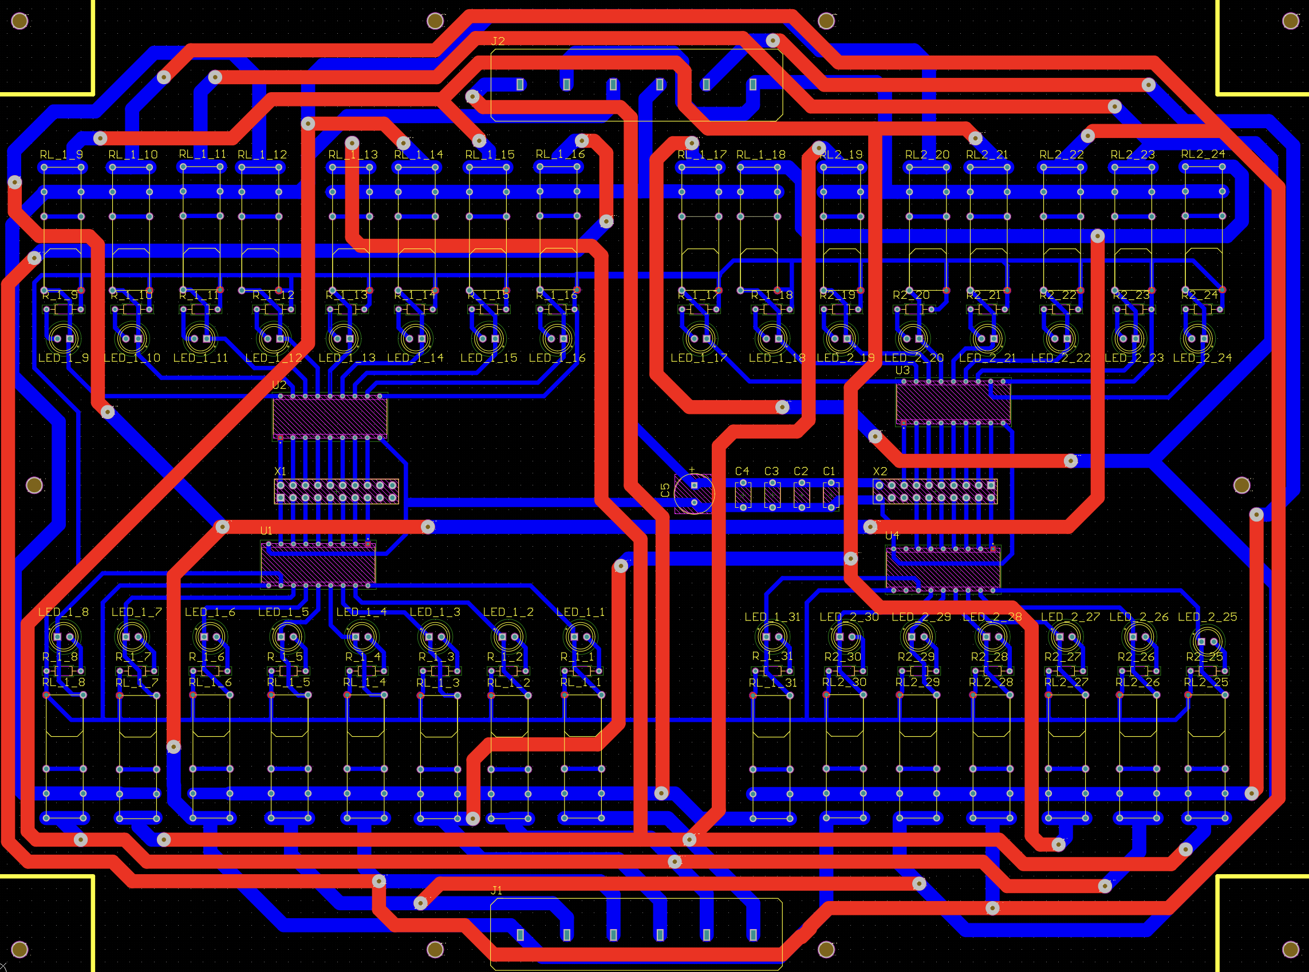
Relay Matrix

Slide 17

Software Development
Sign in & Sign up options
Device connection page ,
Calibration progress page
Excel report generation containing graphs.

Slide 18
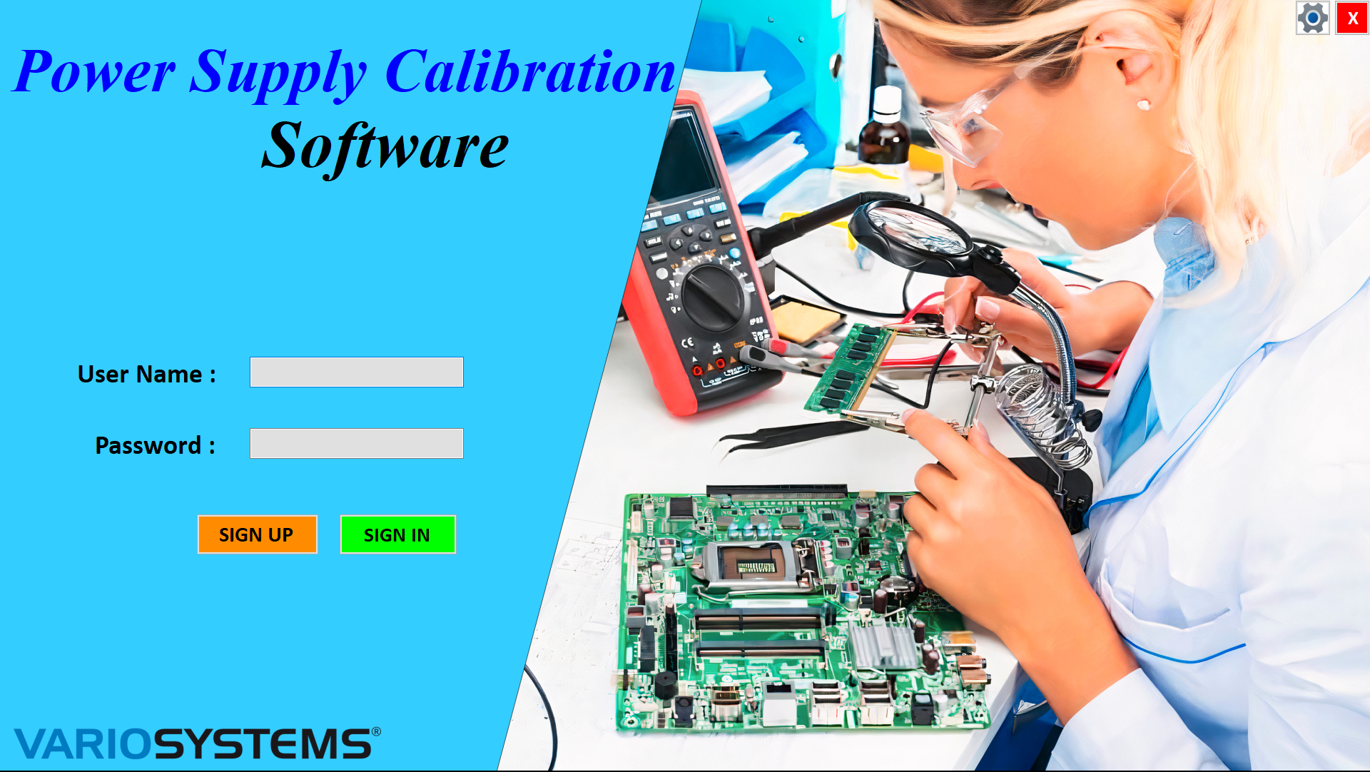
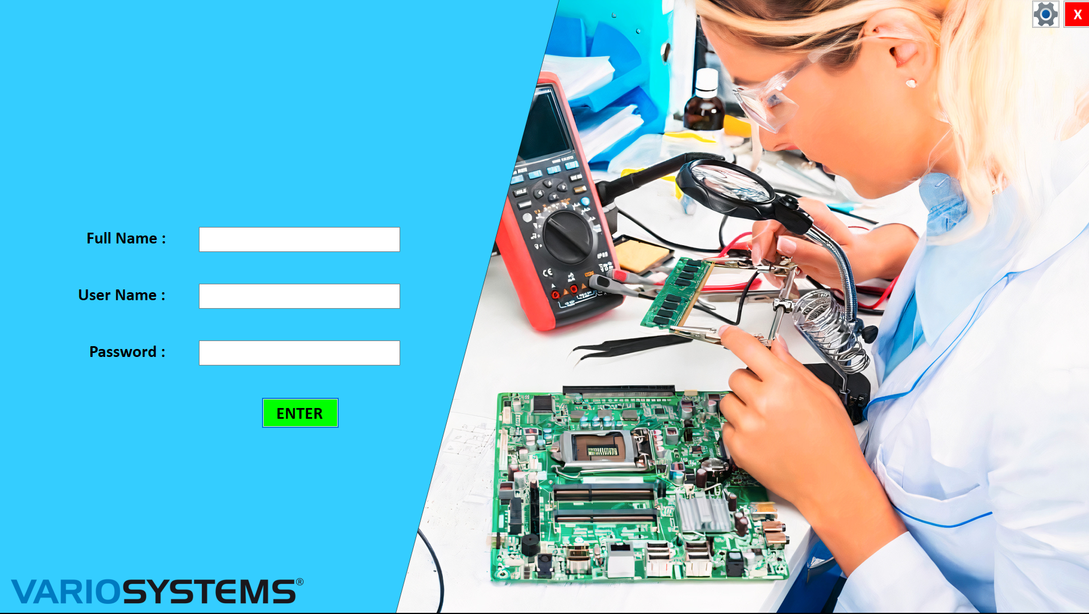
Sign in & Sign up options

Slide 19
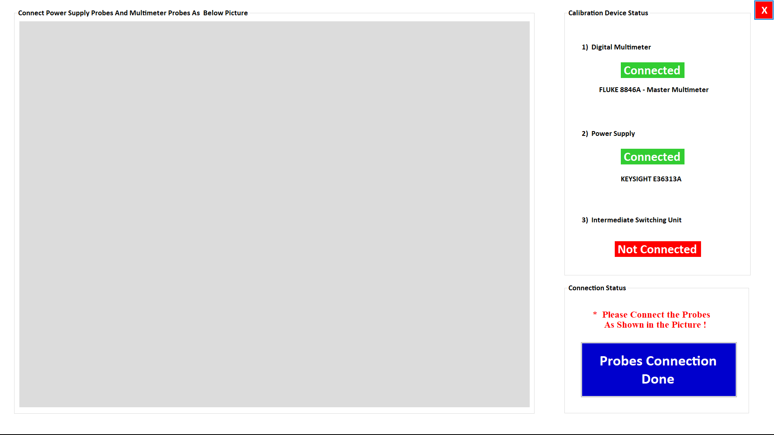
Device connection page

Slide 20
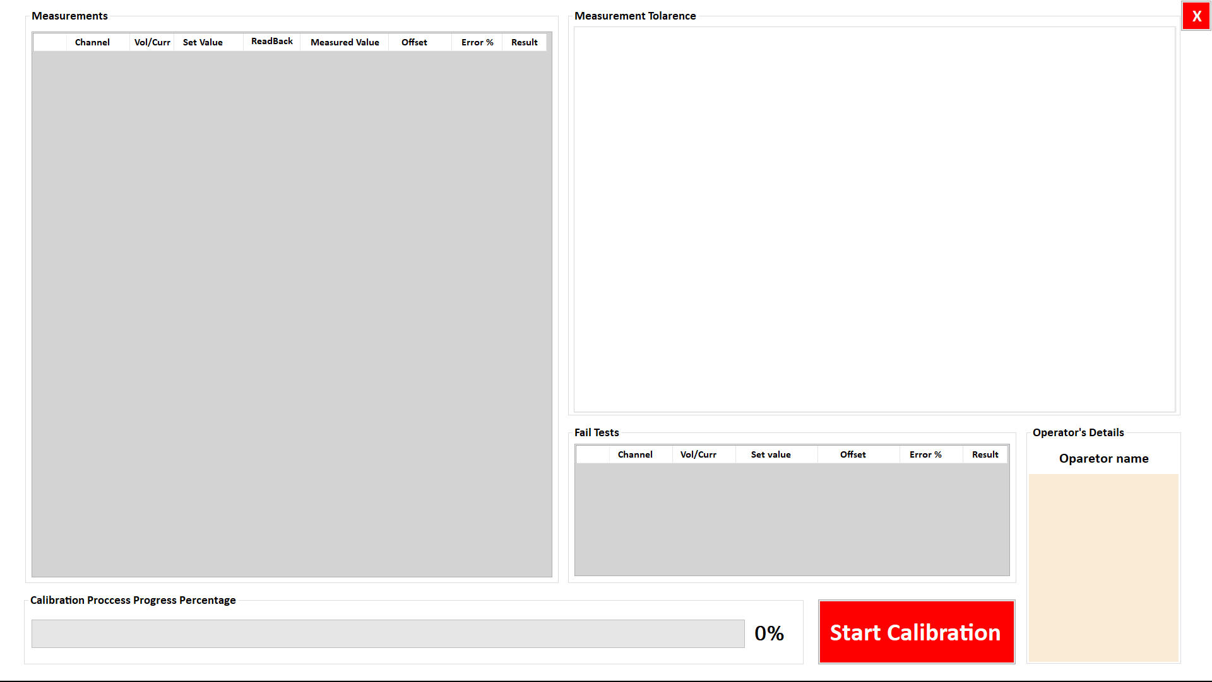
Calibration progress page

Slide 21
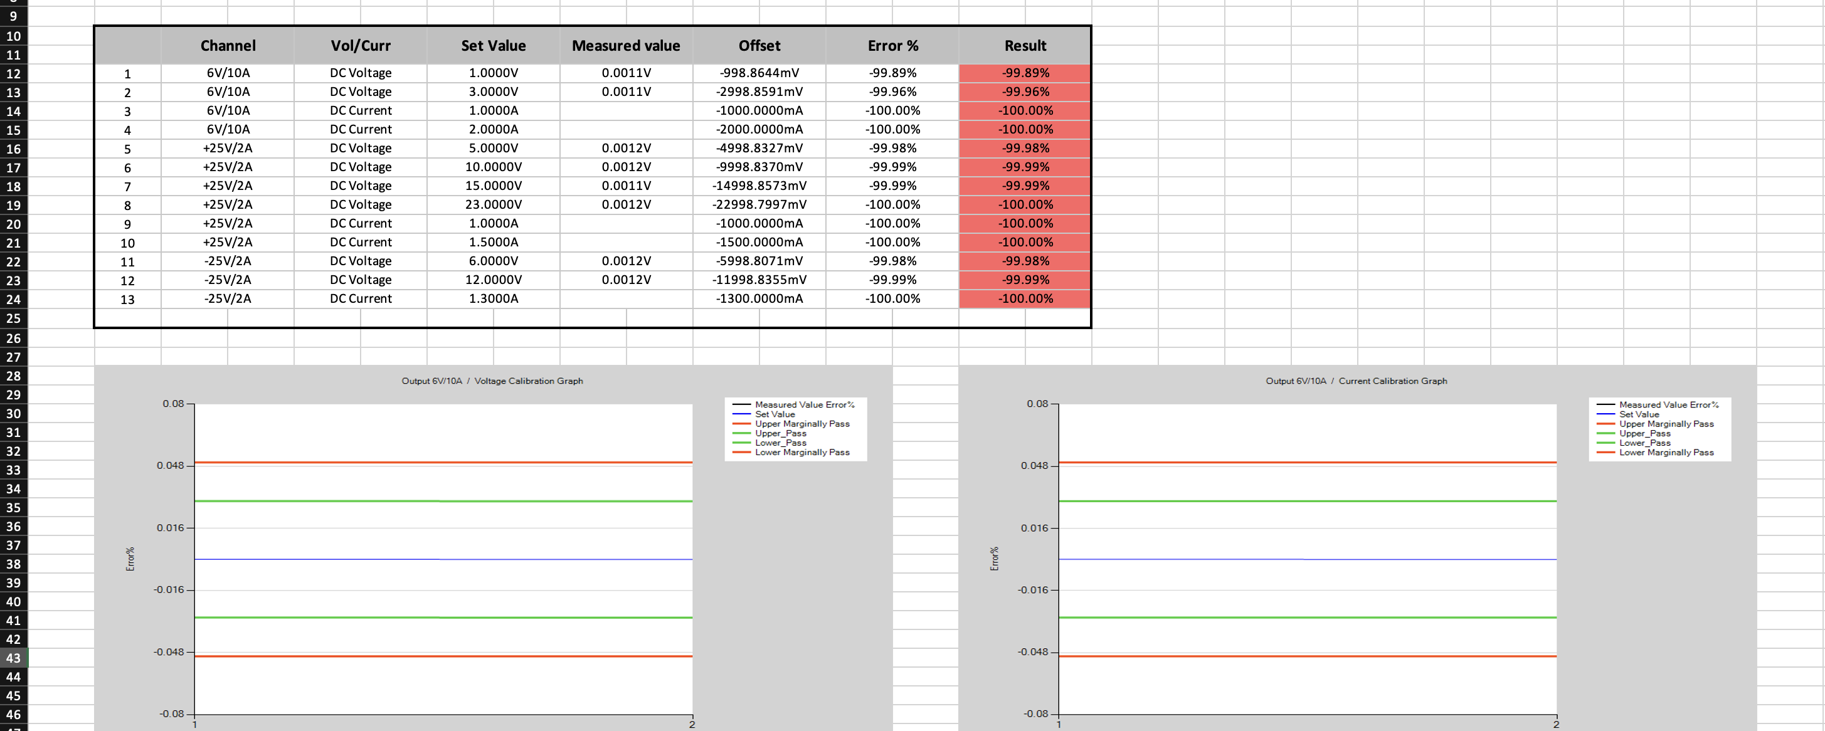
Excel report generation containing graphs.

Slide 22
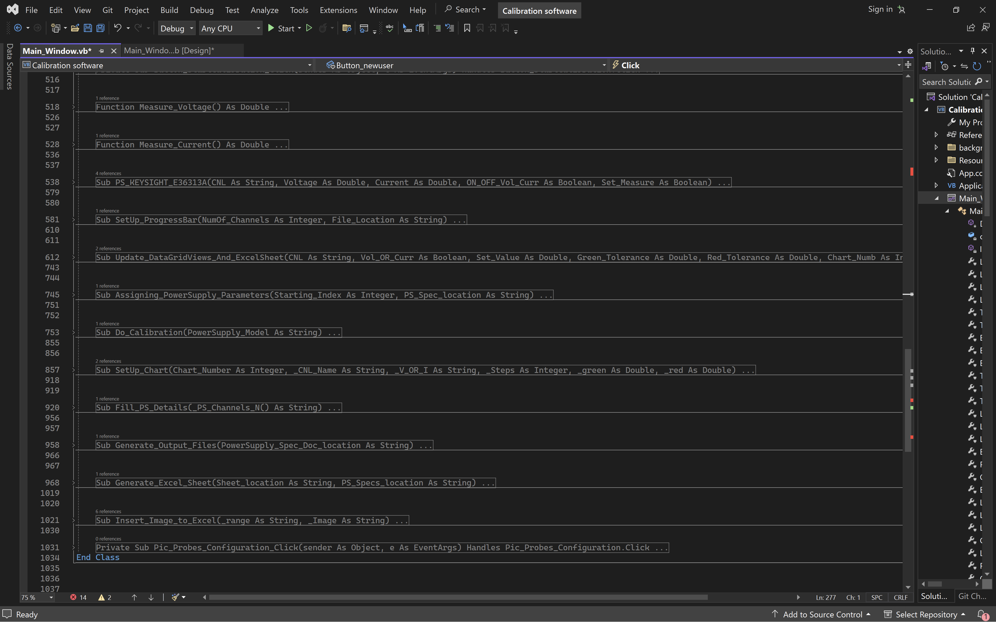
More than 1000 lines of backend code

Slide 23
Current progress.
Decided to Develop existing software To fulfill new project requirements
Since , I’m now familiar with Windows application codes , I was able to update the existing software’s GUI to New version within 2 days.

Slide 24
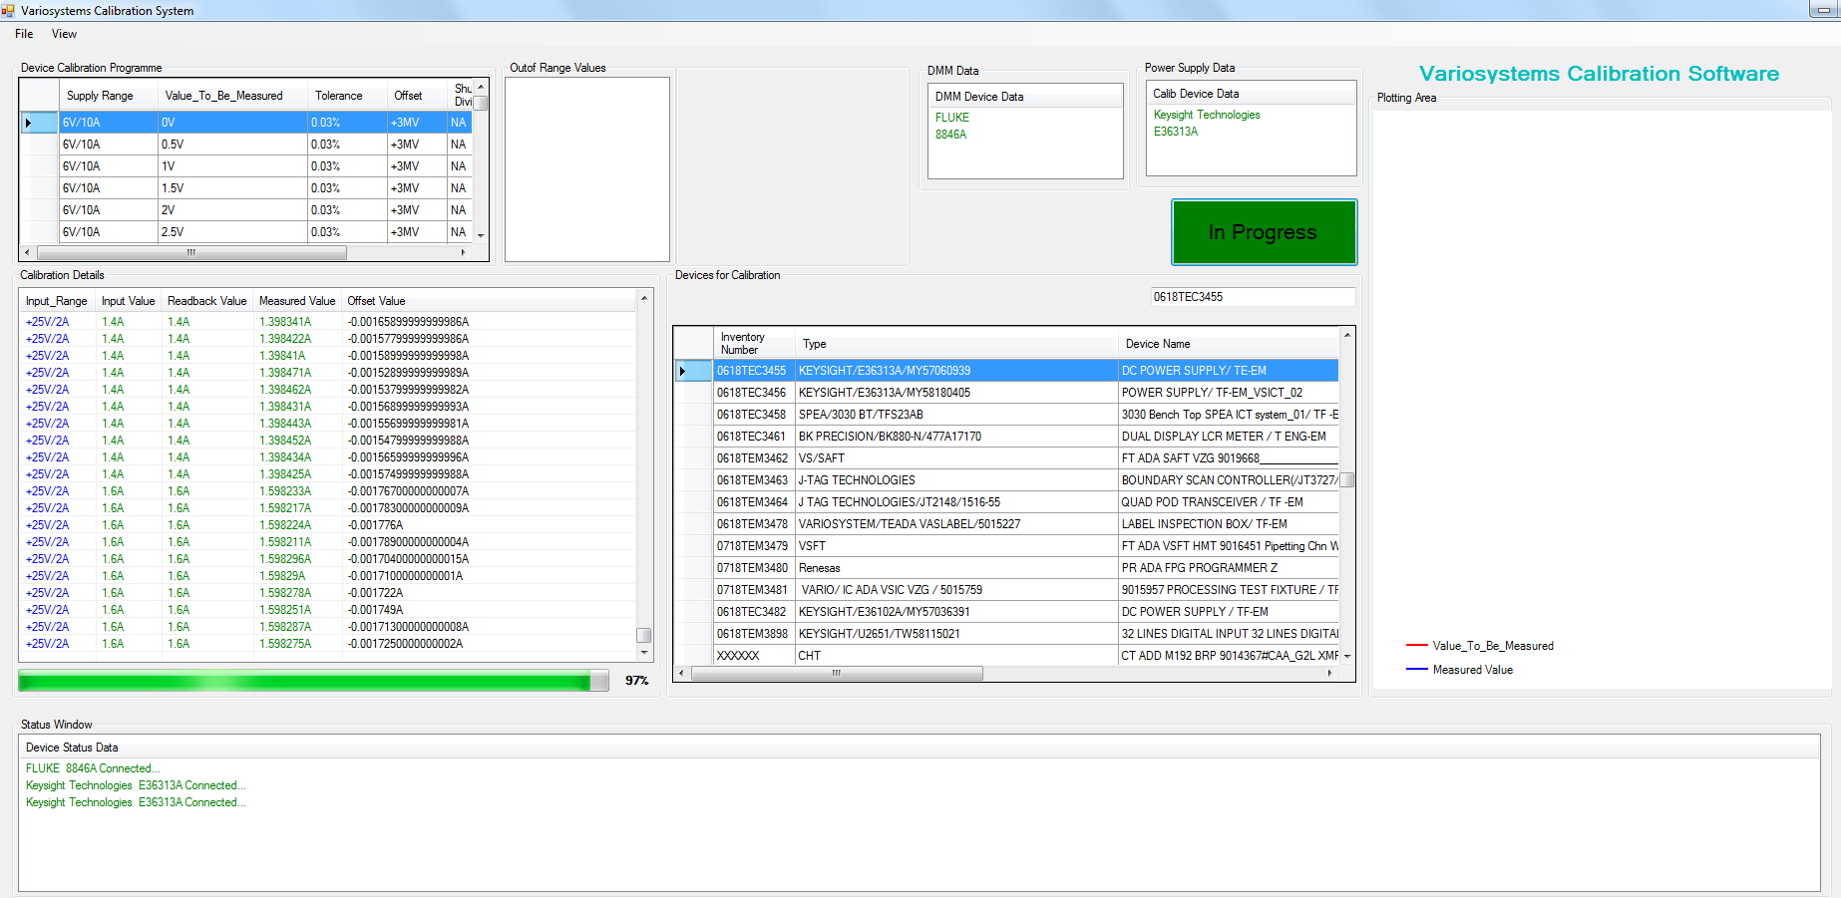
Exist Calibration Software

Slide 25
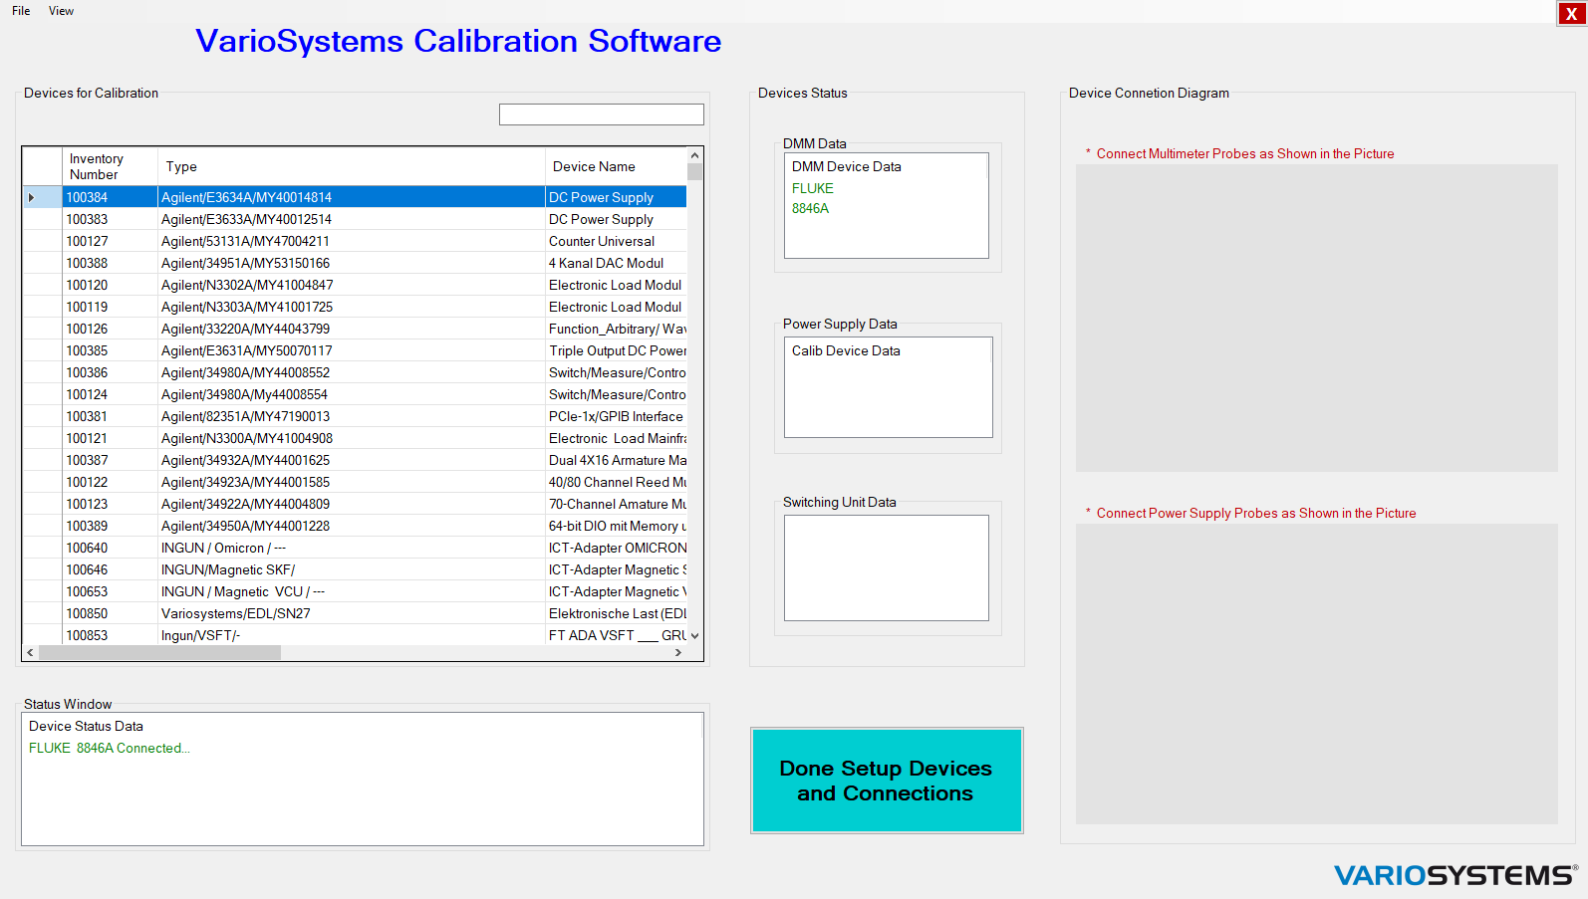

Slide 26
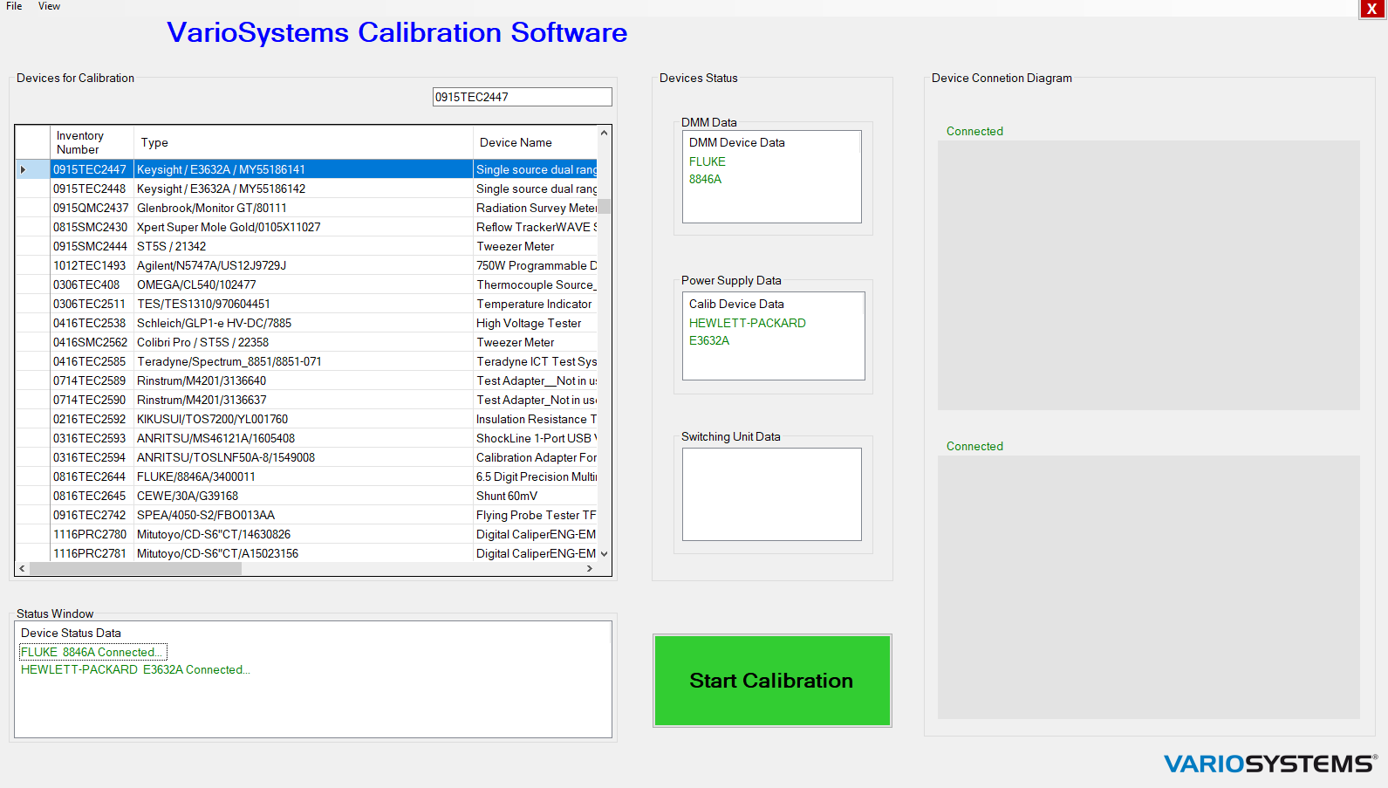

Slide 27
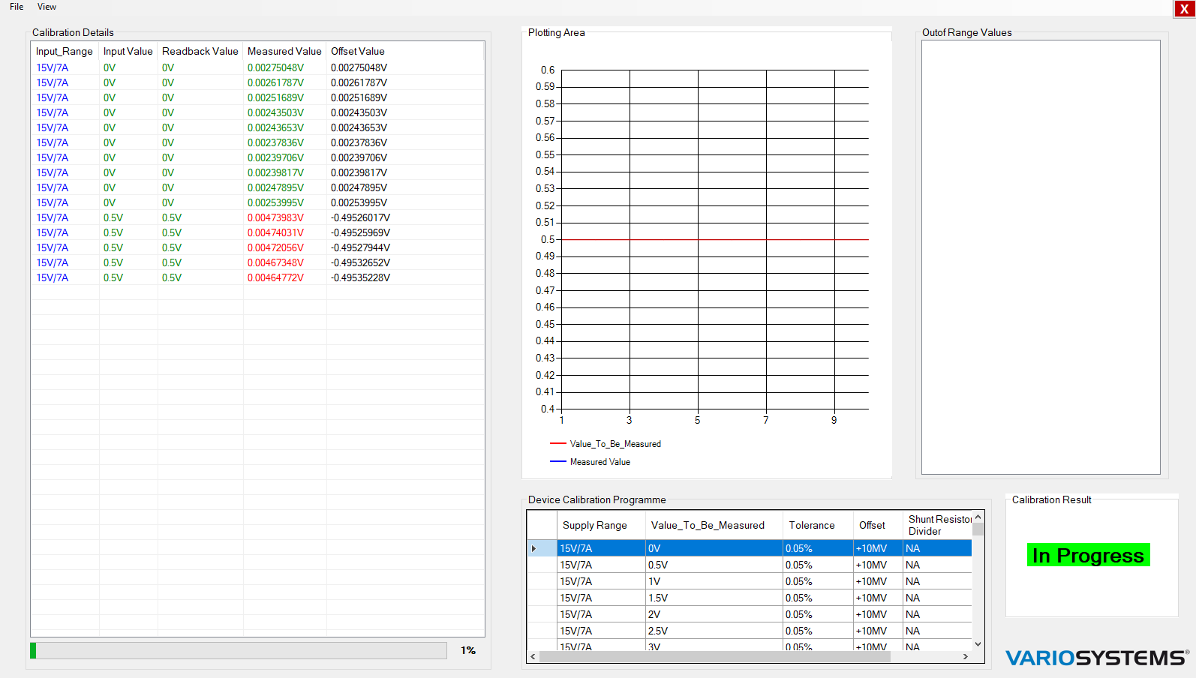

Slide 28
Next Step…..
20A measuring feature
Wire Resistance Checking.
RFID reader

Slide 29
Thank You !

